Slide 1



Course: Data Mining
Bachelor Study Programme: Computer Science and Technology
Lesson 7:
Regression
Ass. prof. E. Pinevich

Slide 2
Learning Objectives
After studying this lesson, you will know:
Prediction tasks are divided into two types: the classification task and the regression task.
The sample is divided into training and verification (test) parts.
The meaning of the linear regression model.
The meaning of the polynomial regression model.
After studying this lesson, you should be able to:
Build a linear regression model.
Build a polynomial regression model.

Slide 3

ISSUE 1: What is a prediction task?
We turn to the study of prediction problems.
Today we will predict numerical features using a very simple linear regression model.
Although, may be not so simple...
 | Height | Weight | Gender | IQ
Vasya | 170 | 80 | 1 | 100
Dasha | 165 | 60 | 0 | 80
Masha | 160 | 50 | 0 | 110
Petya | 200 | 70 | 1 | 50
Prediction
A | 180 | 75 | 1 | ?
There are many objects M with known values of the attribute Y.
Find the value of the Y attribute for the new A$∈$M.
Y is called a target feature.
Notes:
For example, it is an architectural design issue whether a computer will have
a multiply instruction. It is an organizational issue whether that instruction will be
implemented by a special multiply unit or by a mechanism that makes repeated
use of the add unit of the system. The organizational decision may be based on the
anticipated frequency of use of the multiply instruction, the relative speed of the
two approaches, and the cost and physical size of a special multiply unit
Many computer manufacturers offer a family of computer models, all with the same architecture but with differences in organization.
In a class of computers called microcomputers, the relationship between
architecture and organization is very close. Changes in technology not only influence organization but also result in the introduction of more powerful and more
complex architectures. Generally, there is less of a requirement for generation to-generation compatibility for these smaller machines.

Slide 4
PREDICTION TASKS
Predicting the value of a quantitative feature Y is called a regression task.
2. Predicting the value of the nominal (categorical) feature Y is called a classification task.
Notes:
8080: The world’s first general- purpose microprocessor. This was an 8-bit
machine, with an 8-bit data path to memory. The 8080 was used in the first
personal computer, the Altair.
8086: A far more powerful, 16-bit machine. In addition to a wider data path and larger registers, the 8086 sported an instruction cache, or queue, that prefetches a few instructions before they are executed.
80486: The 80486 introduced the use of much more sophisticated and powerful cache technology and sophisticated instruction pipelining. The 80486 also offered a built-in math coprocessor, offloading complex math operations from the main CPU.
Pentium: With the Pentium, Intel introduced the use of superscalar techniques, which allow multiple instructions to execute in parallel.
Pentium Pro: The Pentium Pro continued the move into superscalar organization begun with the Pentium, with aggressive use of register renaming, branch
prediction, data flow analysis, and speculative execution.
Pentium II: The Pentium II incorporated Intel MMX technology, which is designed specifically to process video, audio, and graphics data efficiently.

Slide 5
Example. PREDICTION TASKS
 | Height | Weight | Gender | IQ
Vasya | 170 | 80 | 1 | 100
Dasha | 165 | 60 | 0 | 80
Masha | 160 | 50 | 0 | 110
Petya | 200 | 70 | 1 | 50
For example, predicting IQ is a regression task, and predicting gender is a classification task.
A | 180 | 75 | 1 | ?
Notes:
In general terms, there are only four basic functions that a computer can perform.

Slide 6
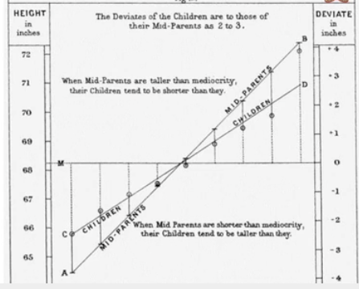
19-th сentury research
In the 19-th century, a study was conducted on the dependence of the son's height on the height of his father.
It was noticed that "the son's height approached (regressed) to the average height of men."
Notes:
There are four main structural components
■ Control unit: Controls the operation of the CPU and hence the computer.
■ Arithmetic and logic unit (ALU): Performs the computer’s data processing functions.
■ Registers: Provides storage internal to the CPU.
■ CPU interconnection: Some mechanism that provides for communication among the control unit, ALU, and registers.
In recent years, there has been increasing use of multiple processors in a single computer. Some design issues relating to multiple processors crop up

Slide 7
ISSUE 2: The general plan for solving the regression problem
Divide the set of objects into 2 sets: a training sample and a test sample.
The prediction model is based on Train objects, and the quality of the model is checked by Test objects.
 | Height | Weight | Gender | IQ
Vasya | 170 | 80 | 1 | 100
Dasha | 165 | 60 | 0 | 80
Masha | 160 | 50 | 0 | 110
Petya | 200 | 70 | 1 | 50
Train objects
Test objects
 | Height | Weight | Gender | IQ
Vasya | 170 | 80 | 1 | 100
Dasha | 165 | 60 | 0 | 80
 | Height | Weight | Gender | IQ
Masha | 160 | 50 | 0 | 110
Petya | 200 | 70 | 1 | 50
Notes:
Moore observed that the number of transistors that could be
put on a single chip was doubling every year, and correctly predicted that this pace
would continue into the near future.
3. The computer becomes smaller, making it more convenient to place in a variety of environments.
4. There is a reduction in power requirements.
5. The interconnections on the integrated circuit are much more reliable than
solder connections. With more circuitry on each chip, there are fewer interchip connections.

Slide 8
EVALUATING THE QUALITY OF THE MODEL BASED ON THE TEST SELECTION
Let's say we learned how to predict the target feature Y from a training sample.
How can we evaluate the quality of predictions based on a test sample?
 | Height | Weight | Gender | IQ
Masha | 160 | 50 | 0 | 110
Petya | 200 | 70 | 1 | 50
Notes:
The first generation of computers used vacuum tubes for digital logic elements and memory. A number of research and then commercial computers were built using vacuum tubes. For our purposes, it will be instructive to examine perhaps the most
famous first-generation computer, known as the IAS computer. This example illustrates many of the fundamental concepts found in all computer systems.
A fundamental design approach first implemented in the IAS computer is known as the stored-program concept. This idea is usually attributed to the mathematician John von Neumann.
Alan Turing developed the idea at about the same time.
The first publication of the idea was in a 1945 proposal by von Neumann for a new computer, the EDVAC (Electronic Discrete Variable Computer).
In 1946, von Neumann and his colleagues began the design of a new stored program computer, referred to as the IAS computer, at the Princeton Institute for
Advanced Studies. The IAS computer, although not completed until 1952, is the prototype of all subsequent general-purpose computers.
Since the device is primarily a computer, it will have to perform the elementary operations of arithmetic most frequently. These are addition, subtraction, multiplication, and division.
■ Memory buffer register (MBR): Contains a word to be stored in memory or sent
to the I/O unit, or is used to receive a word from memory or from the I/O unit.
■ Memory address register (MAR): Specifies the address in memory of the word
to be written from or read into the MBR.
■ Instruction register (IR): Contains the 8-bit opcode instruction being executed.
■ Instruction buffer register (IBR): Employed to hold temporarily the righthand instruction from a word in memory.
■ Program counter (PC): Contains the address of the next instruction pair to be fetched from memory.
■ Accumulator (AC) and multiplier quotient (MQ): Employed to hold temporarily operands and results of ALU operations. For example, the result of multiplying two 40-bit numbers is an 80-bit number

Slide 9

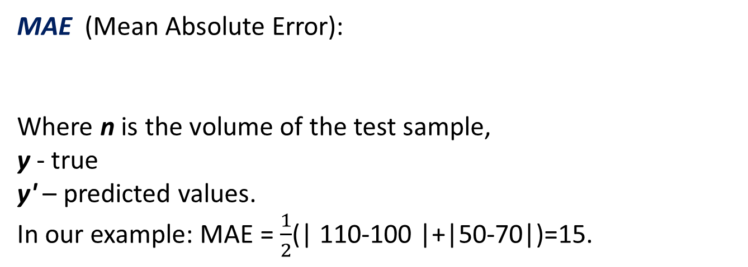
REGRESSION QUALITY INDICATORS
MAE (Mean Absolute Error):
Where n is the volume of the test sample,
y - true
y' – predicted values.
In our example: MAE = $\frac{1}{2}$(| 110-100 |+|50-70|)=15.
 | Height | Weight | Gender | IQ | IQ predicted
Masha | 160 | 50 | 0 | 110 | 100
Petya | 200 | 70 | 1 | 50 | 70
Notes:
Computers generally have multiple processors.
When these processors all reside on a single chip, the term multicore computer is used, and each processing unit (consisting of a control unit, ALU, registers, and perhaps cache) is called a core. To clarify the terminology, this text will use the following definitions.
The main printed circuit board in a computer is called a system board or motherboard
The motherboard contains a slot or socket for the processor chip, which typically contains multiple individual cores, in what is known as a multicore processor.
A chip is a single piece of semiconducting material, typically silicon, upon which electronic circuits and logic gates are fabricated. The resulting product is referred to as an integrated circuit.
Another prominent feature of contemporary computers is the use of multiple layers of memory, called cache memory, between the processor and main memory.
Next, we zoom in on the structure of a single core, which occupies a portion of the processor chip. In general terms, the functional elements of a core are:
■ Instruction logic: This includes the tasks involved in fetching instructions, and decoding each instruction to determine the instruction operation and the memory locations of any operands.
■ Arithmetic and logic unit (ALU): Performs the operation specified by an instruction.
■ Load/store logic: Manages the transfer of data to and from main memory via cache.

Slide 10

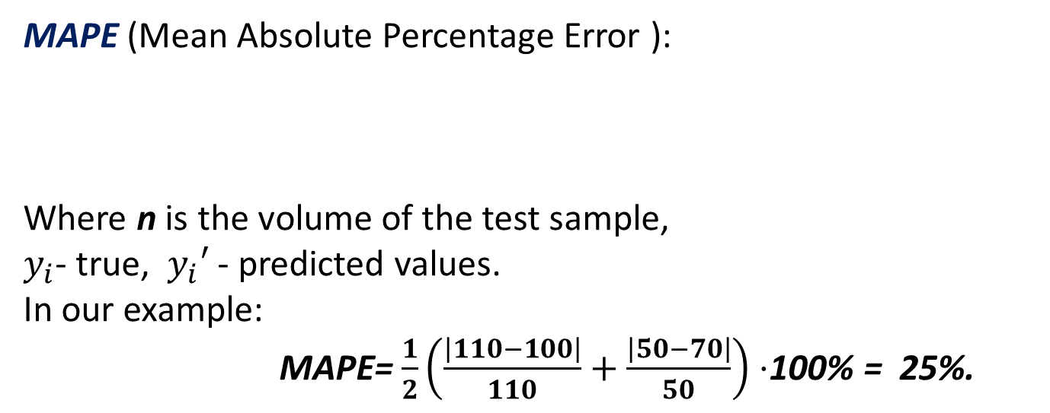
REGRESSION QUALITY INDICATORS
MAPE (Mean Absolute Percentage Error ):
Where n is the volume of the test sample,
$y_{i}$- true, $y_{i}′$ - predicted values.
In our example:
MAPE= $\frac{1}{2}\left(\frac{\left|110−100\right|}{110}+\frac{\left|50−70\right|}{50}\right)⋅$100% = 25%.
 | Height | Weight | Gender | IQ | IQ predicted
Masha | 160 | 50 | 0 | 110 | 100
Petya | 200 | 70 | 1 | 50 | 70
Notes:
Pentium III: The Pentium III incorporates additional floating- point instructions: The Streaming SIMD Extensions (SSE) instruction set extension added 70 new instructions
Core: This is the first Intel x86 microprocessor with a dual core, referring to the implementation of two cores on a single chip
Core 2: The Core 2 extends the Core architecture to 64 bits.
Core i9 :
Core i9 is a family of high-performance and high core count 64-bit x86 microprocessors introduced by Intel in mid-2017

Slide 11
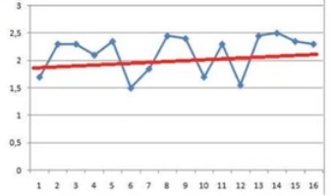
HOW CAN WE PREDICT Y BY THE VALUE OF X?
Nodes are objects of the training sample.
You can predict the Y values at new points using:
a) the blue polyline;
b) the red line is regression line.
What are the "disadvantages" of predicting using a polyline?
Notes:
ARM is a family of RISC-based microprocessors and microcontrollers designed by ARM Holdings, Cambridge, England.
CORTEX-A: These processors run at higher clock frequency (over 1 GHz), and support a memory management unit (MMU), which is required for full feature OSs such as Linux, Android, MS Windows, and mobile Oss
■ Cortex-M0: Designed for 8- and 16-bit applications, this model emphasizes low cost, ultra low power, and simplicity. It is optimized for small silicon die size (starting from 12k gates) and use in the lowest cost chips. ■ Cortex-M0+: An enhanced version of the M0 that is more energy efficient.
■ Cortex- M3: Designed for 16- and 32-bit applications, this model emphasizes performance and energy efficiency. It also has comprehensive debug and trace features to enable software developers to develop their applications quickly.
■ Cortex-M4: This model provides all the features of the Cortex-M3, with additional instructions to support digital signal processing tasks.
■ Cortex-M7: Provides higher performance than the M4. It is still primarily a 32-bit machine but uses 64-bit wide instruction and data buses.
■ Cortex-M23: This model is similar to the M0+, and adds integer divide instructions and some security features.
■ Cortex-M33: This model is similar to the M4, and adds some security features.

Slide 12
THE "CONS" OF A POLYLINE
1. The prediction model has a complexity comparable to the amount of data.
2. The model cannot be interpreted in any way.
3. There is no certainty that there will be small errors in the test sample.
4. A polyline cannot be extrapolated.
Notes:
■ NVIC: Provides configurable interrupt handling abilities to the processor. It
facilitates low- latency exception and interrupt handling, and controls power
management.
■ ETM: An optional debug component that enables reconstruction of program
execution. The ETM is designed to be a high- speed, low- power debug tool
that only supports instruction trace.
■ Debug access port (DAP): This provides an interface for external debug
access to the processor.
■ Debug logic: Basic debug functionality includes processor halt, single- step,
processor core register access, unlimited software breakpoints, and full system
memory access.
■ ICode interface: Fetches instructions from the code memory space.
■ SRAM & peripheral interface: Read/write interface to data memory and
peripheral devices.
■ Bus matrix: Connects the core and debug interfaces to external buses on the
microcontroller.
■ Memory protection unit: Protects critical data used by the operating system
from user applications, separating processing tasks by disallowing access
to each other’s data, disabling access to memory regions, allowing memory
regions to be defined as read-only, and detecting unexpected memory accesses
that could potentially break the system.

Slide 13

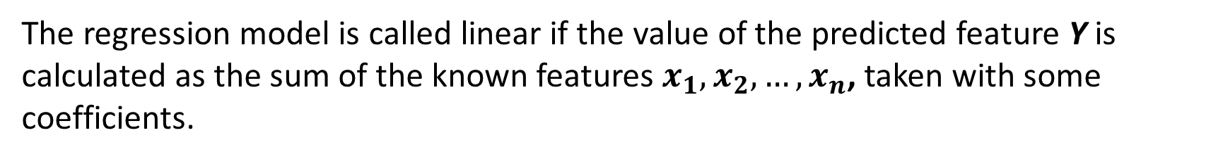

Approximation
The regression model is called linear if the value of the predicted feature Y is calculated as the sum of the known features $x_{1},x_{2},…,x_{n}$, taken with some coefficients.
Where $x_{i}$is an inappropriate feature,
$w_{i}$ is weight.
The task is to find the optimal weights (coefficients) $w_{i.}$

Slide 14
HOW TO SEARCH FOR WEIGHTS?
Principle: for training facilities, it is necessary to minimize the deviation of the predicted values from the true values of Y attribute.
Important: linear regressionis unstable to outliers.
Outliers need to be removed in advance.

Slide 15
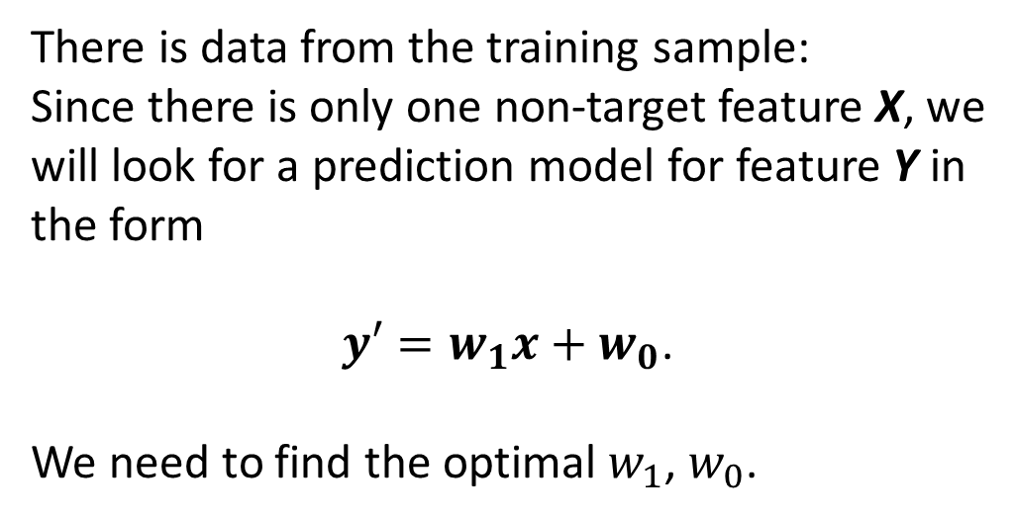
ISSUE 2: How to build a linear regression model?
Еxample
There is data from the training sample:
Since there is only one non-target feature X, we will look for a prediction model for feature Y in the form
$y′=w_{1}x+w_{0}$.
We need to find the optimal $w_{1}$, $w_{0}$.
An object | X | Y
A | -1 | 1
B | 0 | 0
C | 1 | 1
D | 2 | 4
Notes:
A microcontroller chip makes a substantially different use of the logic space available. Microcontrollers are heavily utilized in automation processes.
Another typical feature of a microcontroller is that it does not provide for human interaction. The microcontroller is programmed for a specific task, embedded in its device, and executes as and when required.
A microcontroller is a single chip that contains the processor,
non-volatile memory for the program (ROM), volatile memory for input and output
(RAM), a clock, and an I/O control unit
The processor portion of the microcontroller has a much lower silicon area than other microprocessors and much higher energy efficiency.

Slide 16
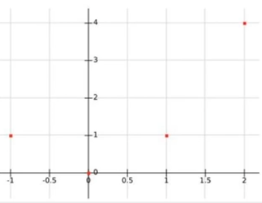
Еxample
You can put points on a plane. And imagine how to draw a straight line so that the sum that the deviation of the points from this line will be minimal?
Notes:
A microcontroller chip makes a substantially different use of the logic space available. Microcontrollers are heavily utilized in automation processes.
Another typical feature of a microcontroller is that it does not provide for human interaction. The microcontroller is programmed for a specific task, embedded in its device, and executes as and when required.
A microcontroller is a single chip that contains the processor,
non-volatile memory for the program (ROM), volatile memory for input and output
(RAM), a clock, and an I/O control unit
The processor portion of the microcontroller has a much lower silicon area than other microprocessors and much higher energy efficiency.

Slide 17
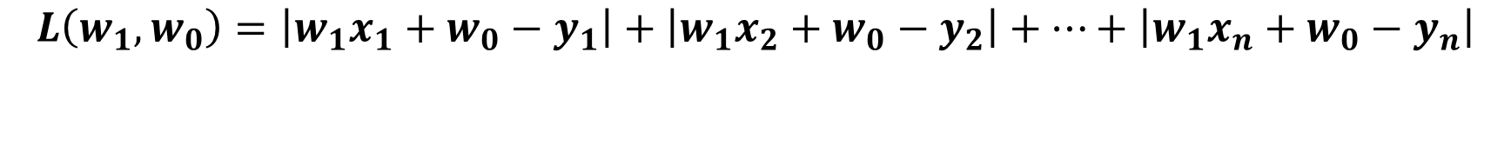

WHAT SHOULD BE MINIMIZED?
The deviation of the true value from the predicted value is
This value should be minimized for all objects in the training sample.
In other words, the smaller the value of the expression
so much the better.
$$\left|y^{′}−y\right|=\left|w_{1}x+w_{0}−y\right|.$$
$$L\left(w_{1},w_{0}\right)=\left|w_{1}x_{1}+w_{0}−y_{1}\right|+\left|w_{1}x_{2}+w_{0}−y_{2}\right|+…+\left|w_{1}x_{n}+w_{0}−y_{n}\right|$$
Notes:
A microcontroller chip makes a substantially different use of the logic space available. Microcontrollers are heavily utilized in automation processes.
Another typical feature of a microcontroller is that it does not provide for human interaction. The microcontroller is programmed for a specific task, embedded in its device, and executes as and when required.
A microcontroller is a single chip that contains the processor,
non-volatile memory for the program (ROM), volatile memory for input and output
(RAM), a clock, and an I/O control unit
The processor portion of the microcontroller has a much lower silicon area than other microprocessors and much higher energy efficiency.

Slide 18
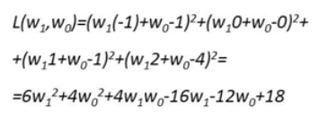
What should be minimized?
Finding the minimum point of this function is complicated by the fact that the module is a function - Undifferentiated. Therefore, in practice, they minimize several another function: the sum of the squares of the deviations. That is, in our example, we need to find the minimum value of the function:
Objects | X | Y
A | -1 | 1
B | 0 | 0
C | 1 | 1
D | 2 | 4
Notes:
The integrated circuit exploits the fact that such components as transistors, resistors, and conductors can be fabricated from a semiconductor such as silicon. It is merely an extension of the solid-state art to fabricate an entire circuit in a tiny piece of silicon rather than assemble discrete components made from separate pieces of silicon into the same circuit. Many transistors can be produced at the same time on a single wafer of silicon. Equally important, these transistors can be connected with a process of metallization to form circuits.
A thin wafer of silicon is divided into a matrix of small areas, each a few millimeters square. The identical circuit pattern is fabricated in each area, and the wafer is broken up into chips. Each chip consists of many gates and/or memory cells plus a number of input and output attachment points

Slide 19
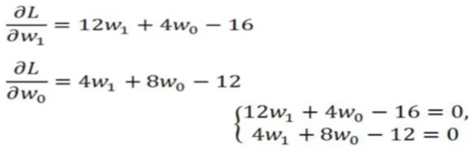
How do we find the minimum point?
Calculating partial derivatives
We equate the partial derivatives to zero and solve the system of equations.
Notes:
A microcontroller chip makes a substantially different use of the logic space available. Microcontrollers are heavily utilized in automation processes.
Another typical feature of a microcontroller is that it does not provide for human interaction. The microcontroller is programmed for a specific task, embedded in its device, and executes as and when required.
A microcontroller is a single chip that contains the processor,
non-volatile memory for the program (ROM), volatile memory for input and output
(RAM), a clock, and an I/O control unit
The processor portion of the microcontroller has a much lower silicon area than other microprocessors and much higher energy efficiency.

Slide 20
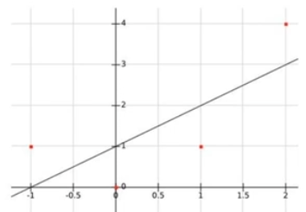
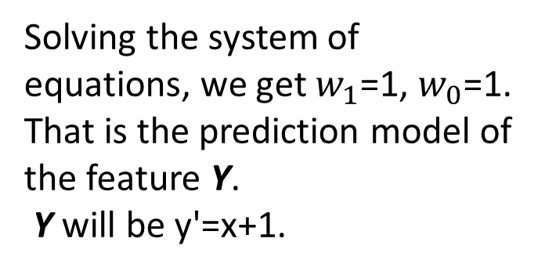
WE GET A PREDICTION MODEL
Solving the system of equations, we get $w_{1}$=1, $w_{0}$=1. That is the prediction model of the feature Y.
Y will be y'=x+1.
Notes:
A microcontroller chip makes a substantially different use of the logic space available. Microcontrollers are heavily utilized in automation processes.
Another typical feature of a microcontroller is that it does not provide for human interaction. The microcontroller is programmed for a specific task, embedded in its device, and executes as and when required.
A microcontroller is a single chip that contains the processor,
non-volatile memory for the program (ROM), volatile memory for input and output
(RAM), a clock, and an I/O control unit
The processor portion of the microcontroller has a much lower silicon area than other microprocessors and much higher energy efficiency.

Slide 21
IN THE GENERAL CASE
When there are more than one non-target features, everything happens similarly, only there will be more parameters w (and the resulting dependence y'= ... will no longer determine a straight line, but a hyperplane).
Thus, the main difficulty in constructing a linear regression is to solve a system of linear equations at the last step.
Notes:
A microcontroller chip makes a substantially different use of the logic space available. Microcontrollers are heavily utilized in automation processes.
Another typical feature of a microcontroller is that it does not provide for human interaction. The microcontroller is programmed for a specific task, embedded in its device, and executes as and when required.
A microcontroller is a single chip that contains the processor,
non-volatile memory for the program (ROM), volatile memory for input and output
(RAM), a clock, and an I/O control unit
The processor portion of the microcontroller has a much lower silicon area than other microprocessors and much higher energy efficiency.

Slide 22
Is it possible to search for dependence not only using linear functions?
I WOULD LIKE TO…
It would be possible to build nonlinear models and, for example, polynomial ones (polynomial regression).
2. The algorithm for their construction would not differ much from the linear regression algorithm.
Notes:
A microcontroller chip makes a substantially different use of the logic space available. Microcontrollers are heavily utilized in automation processes.
Another typical feature of a microcontroller is that it does not provide for human interaction. The microcontroller is programmed for a specific task, embedded in its device, and executes as and when required.
A microcontroller is a single chip that contains the processor,
non-volatile memory for the program (ROM), volatile memory for input and output
(RAM), a clock, and an I/O control unit
The processor portion of the microcontroller has a much lower silicon area than other microprocessors and much higher energy efficiency.

Slide 23

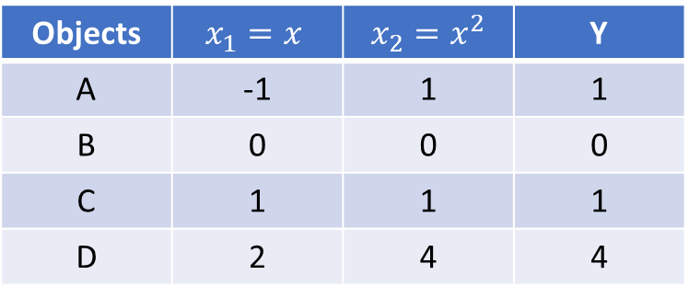
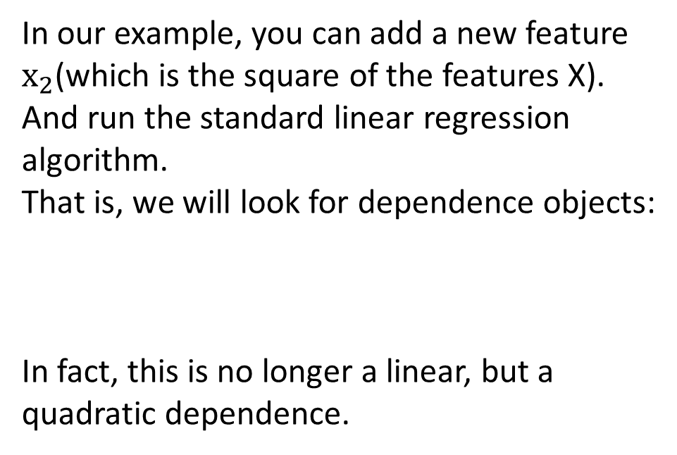
ADD NEW COLUMNS
Objects | X | Y
A | -1 | 1
B | 0 | 0
C | 1 | 1
D | 2 | 4
In our example, you can add a new feature $х_{2}$(which is the square of the features X).
And run the standard linear regression algorithm.
That is, we will look for dependence objects:
In fact, this is no longer a linear, but a quadratic dependence.
Objects | $$x_{1}=x$$ | $$x_{2}=x^{2}$$ | Y
A | -1 | 1 | 1
B | 0 | 0 | 0
C | 1 | 1 | 1
D | 2 | 4 | 4
Notes:
A microcontroller chip makes a substantially different use of the logic space available. Microcontrollers are heavily utilized in automation processes.
Another typical feature of a microcontroller is that it does not provide for human interaction. The microcontroller is programmed for a specific task, embedded in its device, and executes as and when required.
A microcontroller is a single chip that contains the processor,
non-volatile memory for the program (ROM), volatile memory for input and output
(RAM), a clock, and an I/O control unit
The processor portion of the microcontroller has a much lower silicon area than other microprocessors and much higher energy efficiency.

Slide 24
ADD NEW COLUMNS
In general, if you want to find the dependence of the target feature in the form of a polynomial of the k-th degree, then you need to add new columns to the table containing all possible products of non-target variables of degree no more than k.
The table shows the expansion of the table with two non-target features for quadratic regression.
Object | X | Z | XX | ZZ | XZ | Y
A | 1 | 3 | 1 | 9 | 3 | 100
B | 2 | 4 | 4 | 16 | 8 | 200
Notes:
A microcontroller chip makes a substantially different use of the logic space available. Microcontrollers are heavily utilized in automation processes.
Another typical feature of a microcontroller is that it does not provide for human interaction. The microcontroller is programmed for a specific task, embedded in its device, and executes as and when required.
A microcontroller is a single chip that contains the processor,
non-volatile memory for the program (ROM), volatile memory for input and output
(RAM), a clock, and an I/O control unit
The processor portion of the microcontroller has a much lower silicon area than other microprocessors and much higher energy efficiency.

Slide 25
Key Terms
sample approximation minimization prediction MAE MAPE | data table facility object feature sign attribute | linear regression polynomial regression nonlinear models prediction model minimum point training part test part
Notes:
Today we have studied the following concepts
In the next lecture, we will repeat these concepts. You should explain their meaning in a few words. Everyone understands this ?
Until the next lecture

